Slide 1


Team Name: HACKTRIX
Problem Statement:
AI-Powered Mobile Platform for Democratizing Sports Talent Assessment
AI-Powered Mobile Platform for Democratizing Sports Talent Assessment

Slide 2

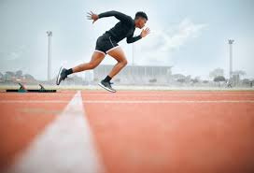
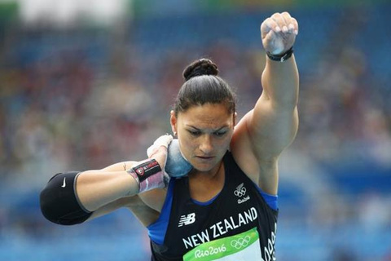
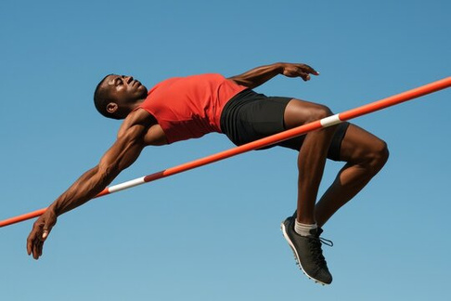
ABSTRACT
Problem:
Hidden sports talent in rural India goes unnoticed.
Lack of fair, transparent, and scalable assessment methods.
Solution:
AI-powered mobile app to assess sprint, long jump, and shot put via video.
Real-time feedback + cheat detection + national profiling database.
Why Now?
Low-cost smartphones + cloud AI = scalable solution.
Rising need for fair talent scouting.

Slide 3
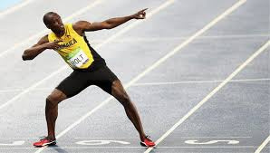
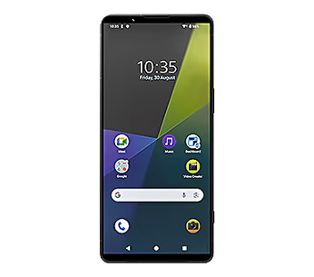

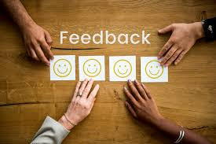
Technical Approach
ROADMAP :
Step 1: Athlete records performance video.
Step 2: AI/ML (MediaPipe, OpenPose, OpenCV) analyzes movements.
Step 3: Metrics & anomalies verified.
Step 4: Instant feedback + gamification on app.
Step 5: Data securely submitted to central sports database.
Tech Stack:
Frontend: React Native
Backend: Python (Flask), Firebase, RDBMS (MYSQL)
AI/ML: Computer Vision + ML Models
Accessability : Entry-level smartphones (future: wearables)

Slide 4
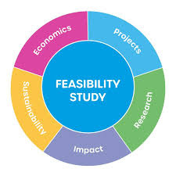
Feasibility & Viability
Feasibility
MVP for 3 events: Boxing ,high jump, shot put
Cloud AI reduces device processing load
Cross-platform = quick rollout
Challenges
⚠️ Multi-angle video accuracy
⚠️ Limited labeled datasets
⚠️ Ensuring cheat-proofing
Mitigation
✅ Start with controlled videos
✅ Use open-source CV repos
✅ Modular, scalable architecture

Slide 5
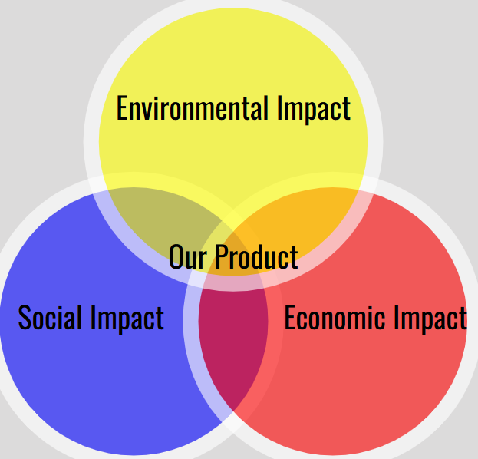
Impact & Benefits
Social Impact:
Democratizes sports talent assessment nationwide
Reaches rural & remote athletes who lack facilities
Promotes fair and transparent evaluation
Economic Impact:
Low-cost, scalable solution for government and academies
Reduces need for physical infrastructure for talent scouting
Environmental Impact:
Digital assessment reduces paper & resource usage
Minimizes travel & physical setup requirements
Overall Benefits:
Identifies hidden athletic talent
Encourages youth participation in sports
Creates data-driven insights for national talent programs

Slide 6
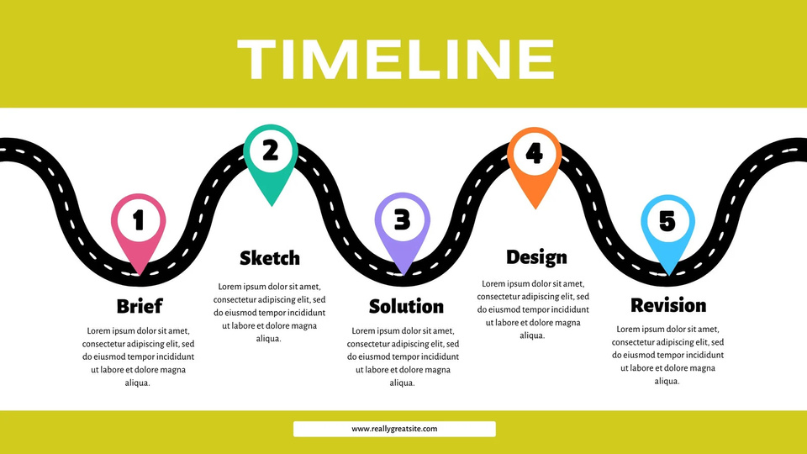
Future Scope & Next Steps
Scalability:
Extend to all athletics events and team sports
Integrate wearable sensors for higher precision
Long-Term Vision:
Nationwide adoption by schools, academies, and government programs
Build centralized athlete performance database
Monetization / Adoption Strategy:
Premium analytics dashboards for academies & coaches
Partnership with Sports Authority of India & state programs
Expand to private coaching apps & international collaborations
Next Steps:
Develop MVP for Boxing, High jump, shot put
Collect controlled video dataset for AI training
Test AI analysis & mobile app prototype
Gather feedback & iterate for larger rollout

Slide 7
Our Team
NAME REGISTRATION NO EMAIL
1.ALLOCIOUS FRANKLIN 243115104006 r.alloociousfrankin@gmail.com
2.AKASH N 243115104003 243115104003@msec.edu.in
3.AKASH MADHAV 243115104004 243115104004@msec.edu.in
4.ANANTHARAM 243115104007 243115104007@msec.edu.in
5.Mohammed Al Silmi 243115104059 243115104061@msec.edu.in

Slide 8
THANK YOU
Empowering India’s Hidden Talent with AI.

